Slide 1


RETAIL STORE ANALYSIS
SQL

Slide 2

Project Overview
Project Title: Retail Sales
Analysis Skill Level: Beginner
Database: p1_retail_db
This project is a hands-on journey through the world of retail data, designed to help you sharpen your SQL skills while solving real business challenges. Whether you’re just starting or looking to deepen your expertise, this project offers a structured approach to exploring, cleaning, and analyzing retail sales data. By the end of this project, you’ll have gained a solid knowledge on how SQL is used to turn raw sales data into valuable business insights.

Slide 3
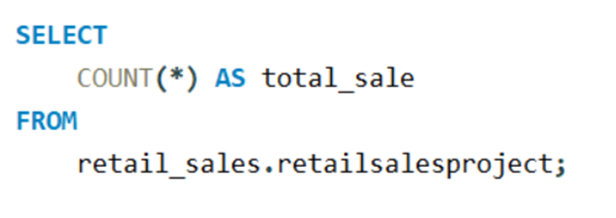
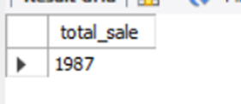
# how many sales we have

Slide 4

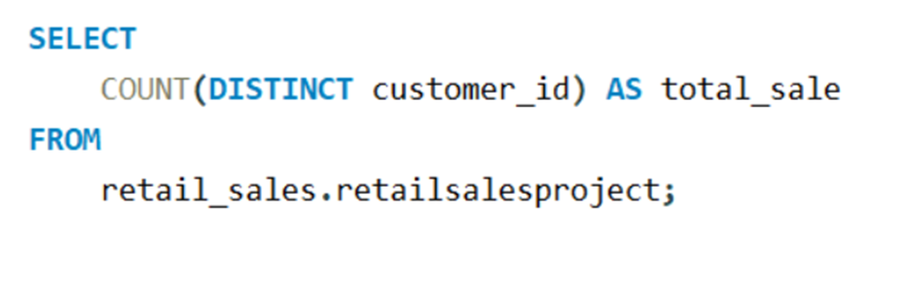
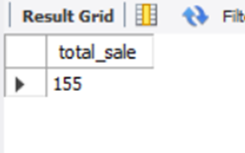
# total no.of unique customers

Slide 5
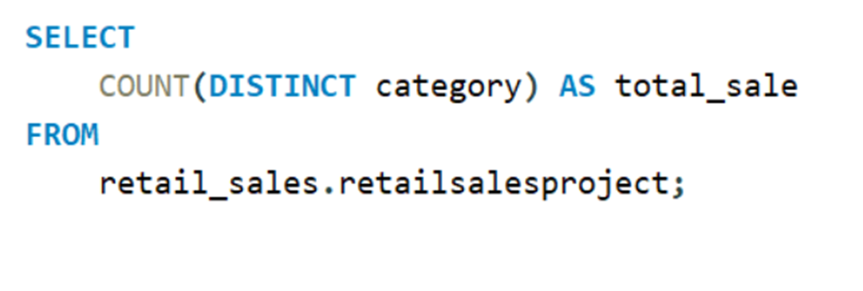
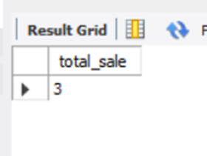
# no.of unique categories

Slide 6
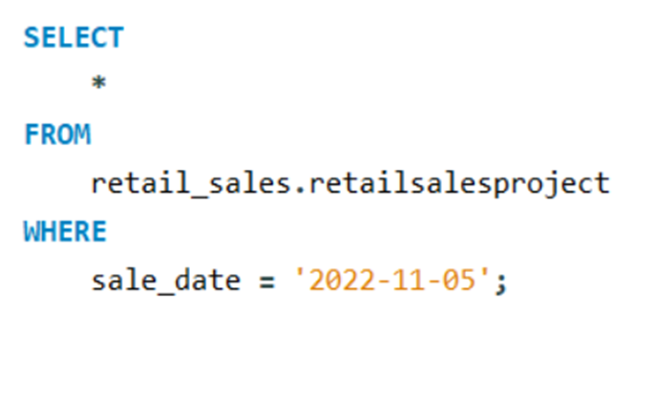
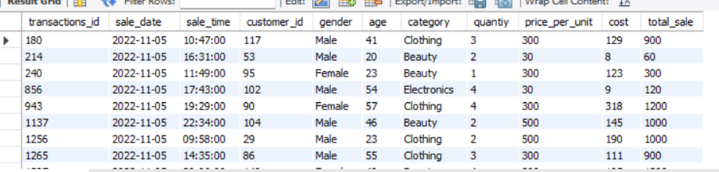
# Write a SQL query to retrieve all columns for sales made on '2022-11-05

Slide 7
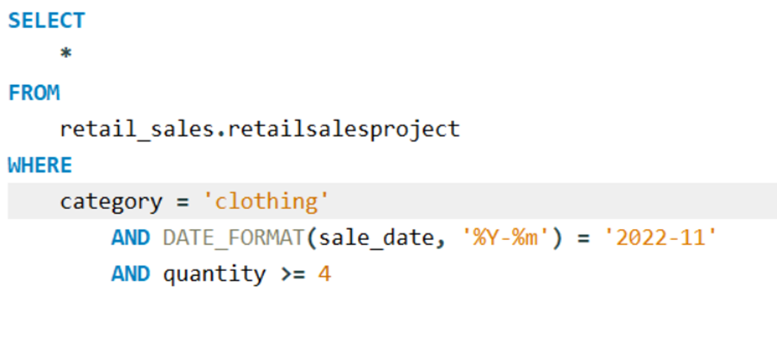
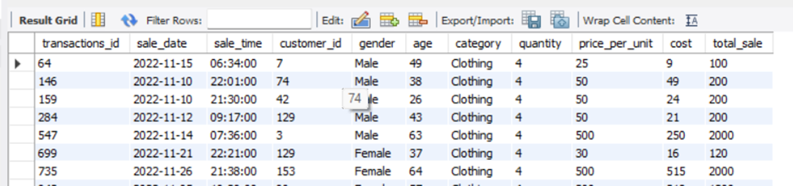
# Write a SQL query to retrieve all transactions where the category is 'Clothing' and the quantity sold is more than 4 in the month of Nov-2022

Slide 8
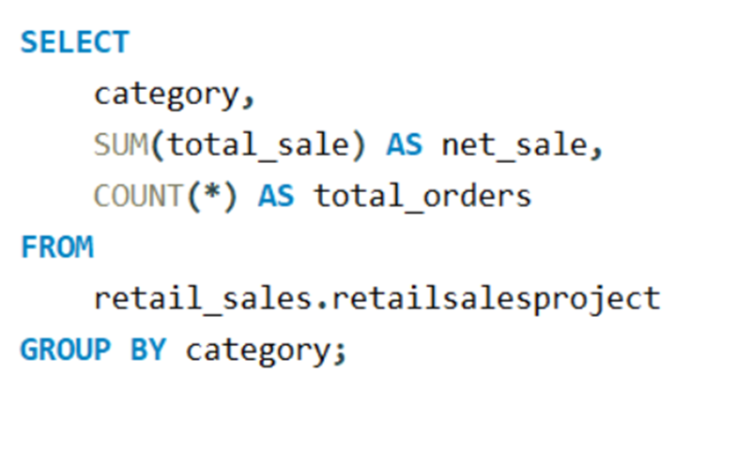
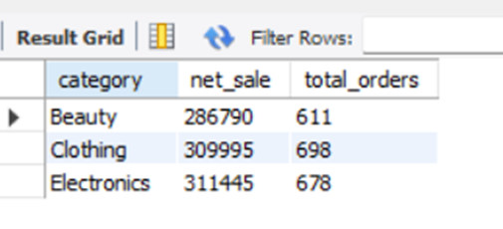
# Write a SQL query to calculate the total sales (total_sale) for each category

Slide 9
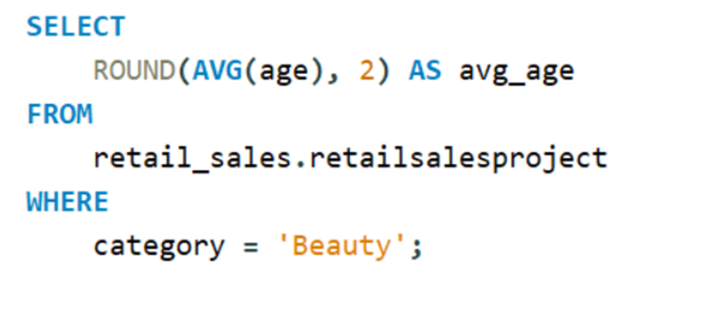
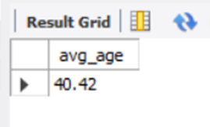
# Write a SQL query to find the average age of customers who purchased items from the 'Beauty' category

Slide 10
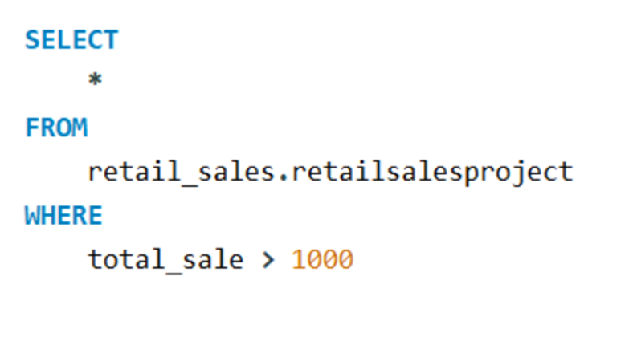
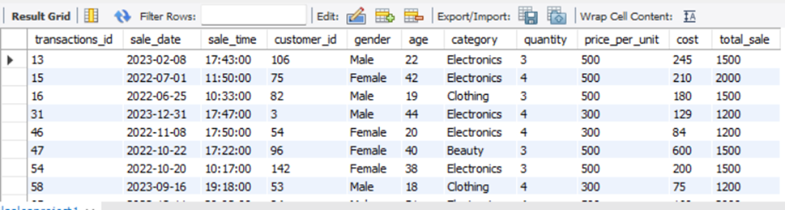
# Write a SQL query to find all transactions where the total_sale is greater than 1000

Slide 11
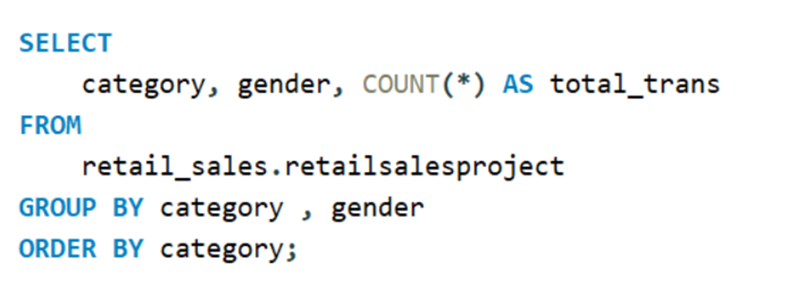
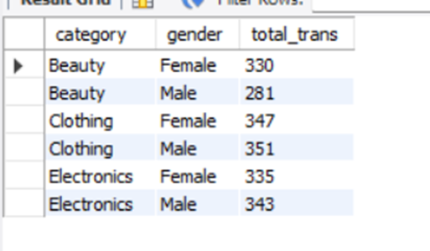
# Write a SQL query to find the total number of transactions (transaction_id) made by each gender in each category

Slide 12
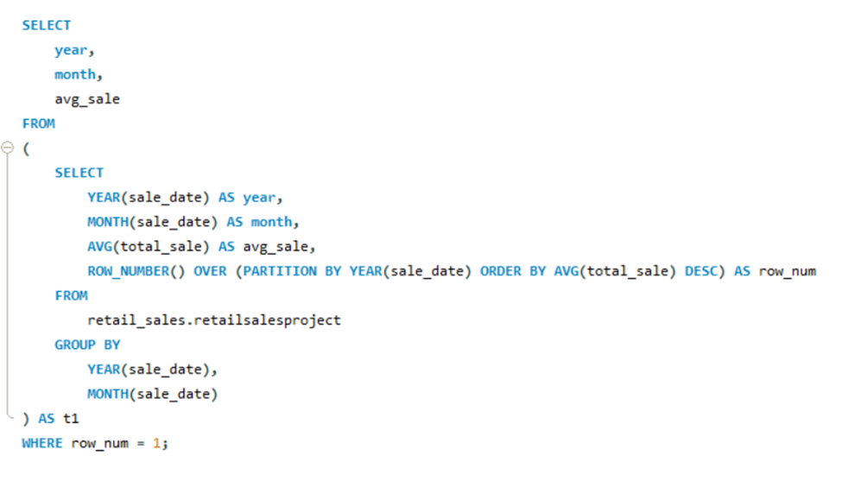
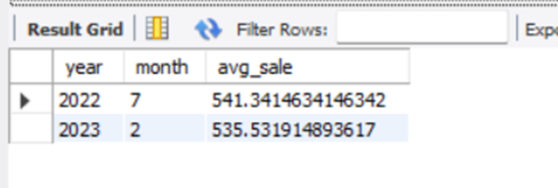
# Write a SQL query to calculate the average sale for each month. Find out best selling month in each year

Slide 13
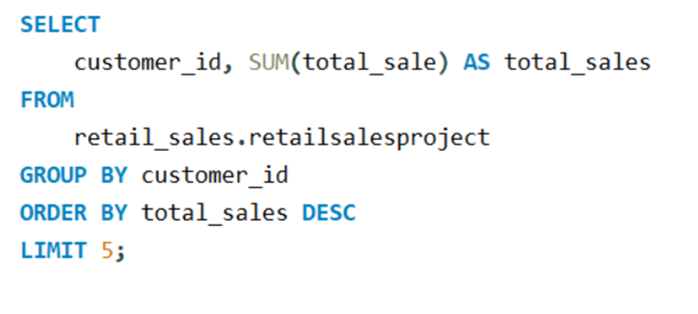
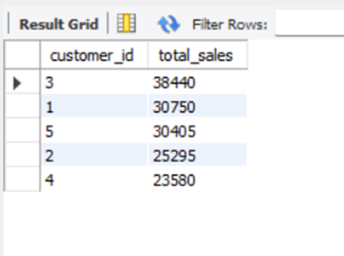
# Write a SQL query to find the top 5 customers based on the highest total sales

Slide 14
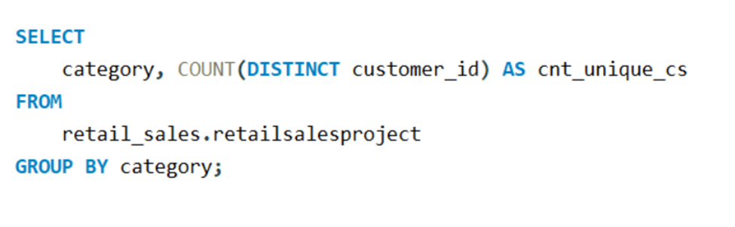
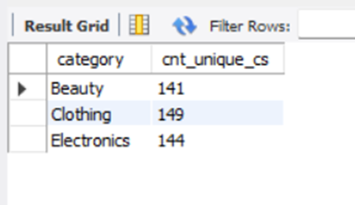
# Write a SQL query to find the number of unique customers who purchased items from each category

Slide 15
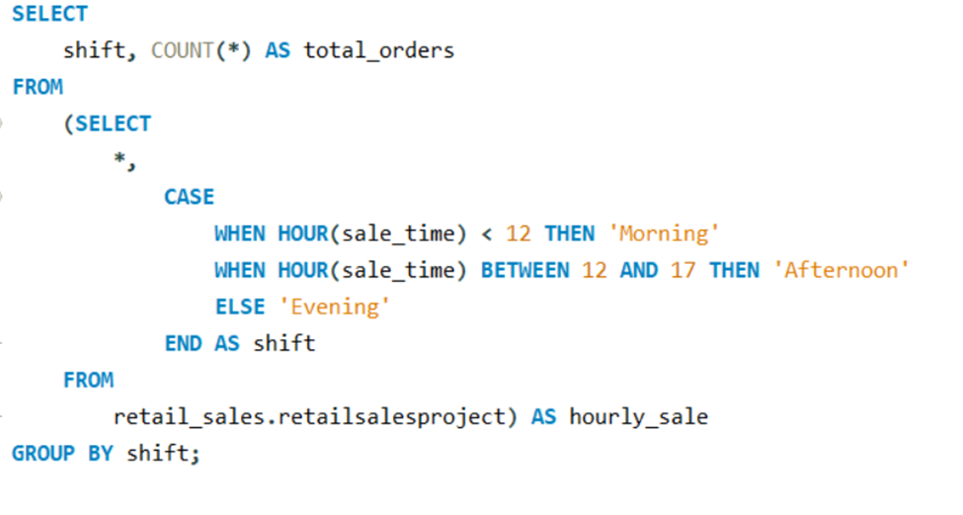
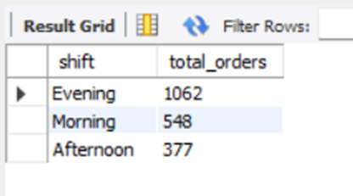
# Write a SQL query to create each shift and number of orders (Example Morning <12, Afternoon Between 12 & 17, Evening >17)

